Slide 1
Application Layer

Slide 2
Name space
The names assigned to machines must be unique because the addresses are unique
A name space that maps each address to a unique name can be organized in two
ways
flat
hierarchical

Slide 3
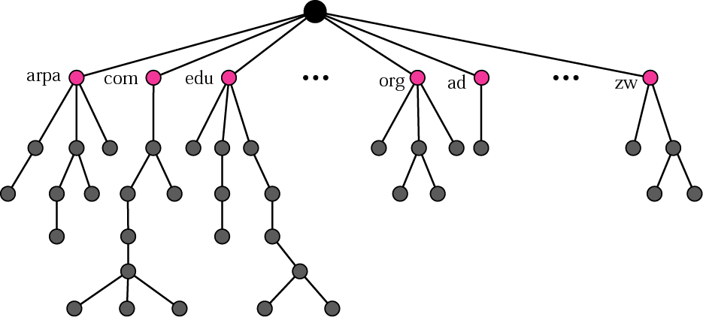
Domain Name Space (DNS)
The domain name space is hierarchical in design
The names are defined in an inverted-tree structure with the root at the top
The tree can have 128 levels: level 0 (root) to level 127

Slide 4
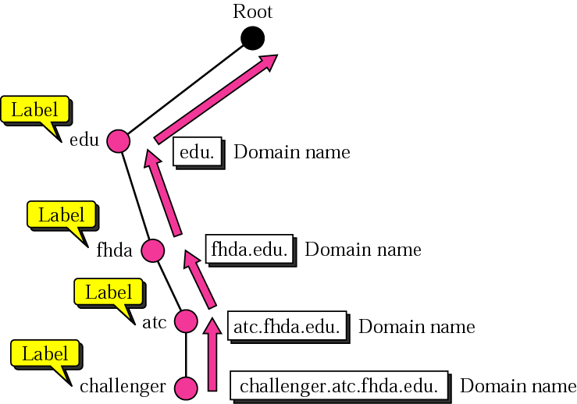
Domain Name and Labels

Slide 5
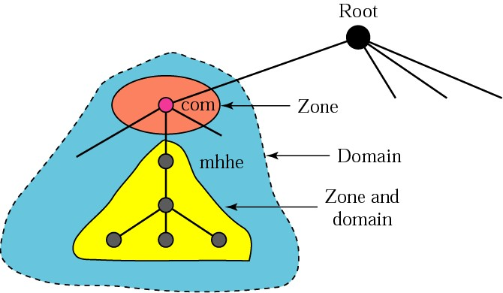
Zones and domains

Slide 6
Zones and domains
A primary server loads all information from the disk file
The secondary server loads all information from the primary server
When the secondary downloads information from the primary, it is called zone transfer

Slide 7
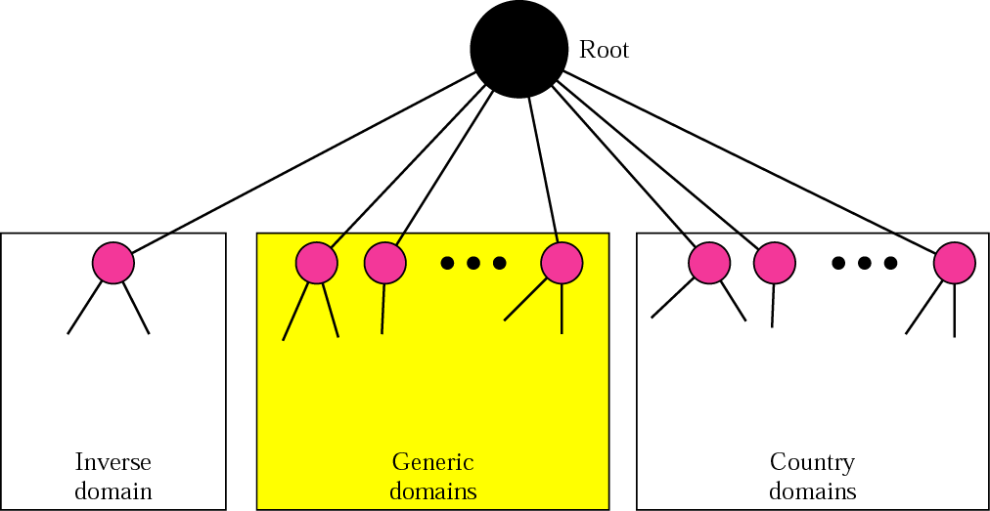
DNS in the internet
The domain name space (tree) is divided into three different sections
generic domains
country domains
inverse domain
DNS used in the Internet

Slide 8
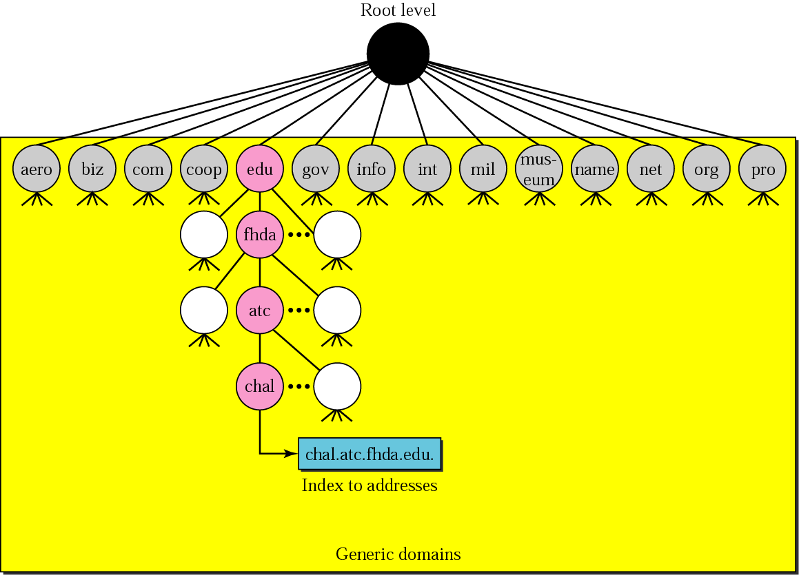
Generic domain

Slide 9
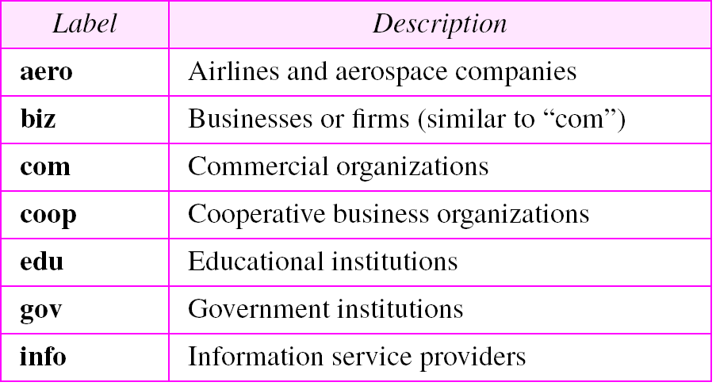
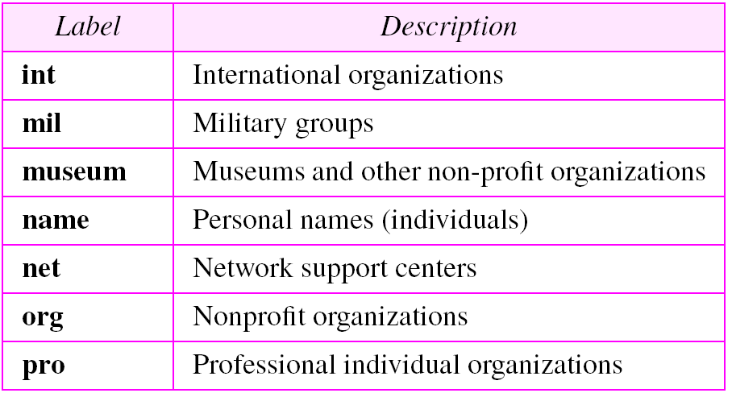
Generic domain labels

Slide 10
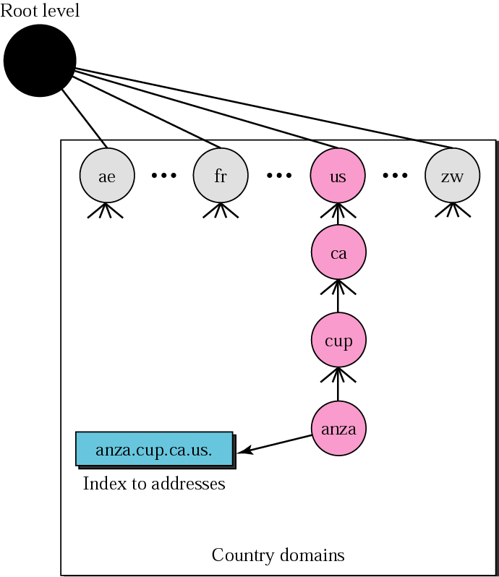
Country domain

Slide 11
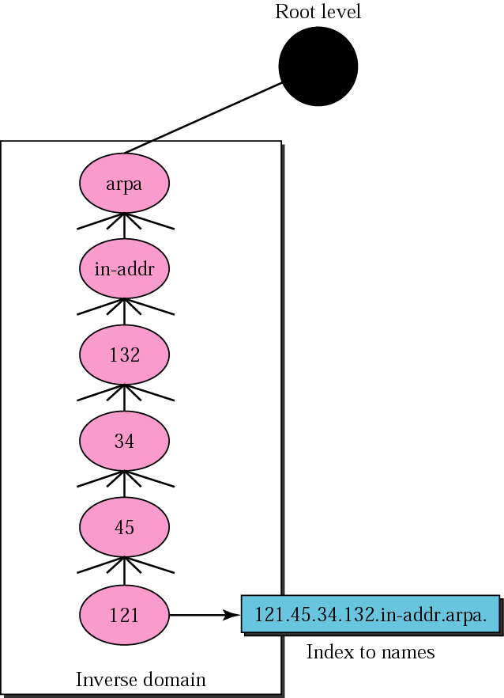
Inverse domain

Slide 12
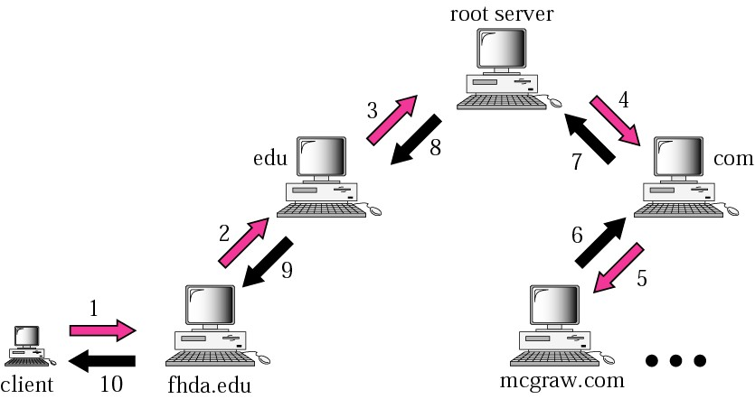
Resolution (Address mapping)
Mapping a name to an address or an address to a name is called name-address resolution
Recursive resolution

Slide 13
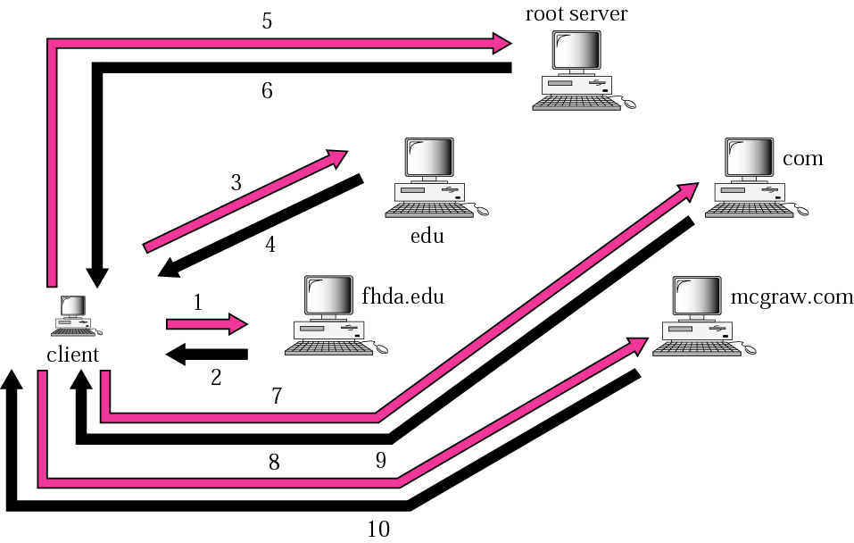
Iterative resolution

Slide 14
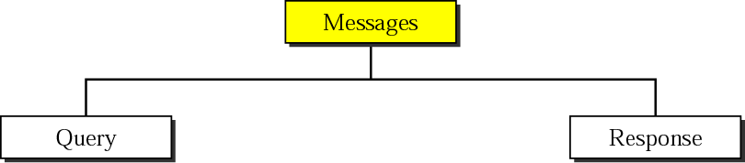
DNS messages
The DNS query message consists of a
Header
Question records
The DNS response message consists of a
Header
question records
answer records
authoritative records
additional records

Slide 15
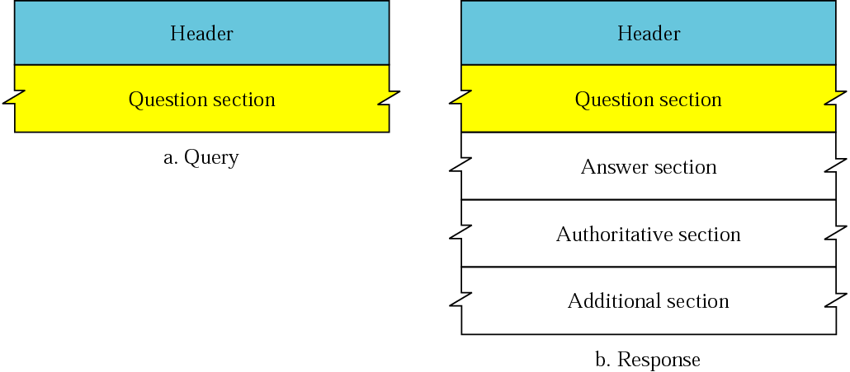
Query and response messages

Slide 16
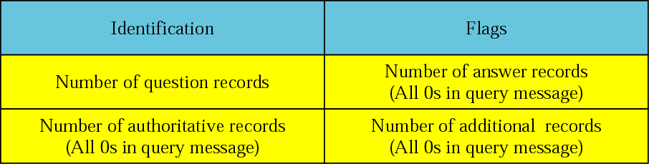
Header format

Slide 17
FTP
File Transfer Protocol (FTP) is the standard mechanism provided by TCP/IP for copying a file from one host to another

Slide 18
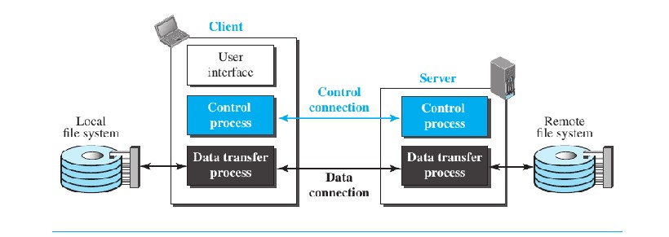
FTP
FTP uses the services of TCP
It needs two TCP connections
The well-known port 21 is used for the control connection and the well-known
port 20 for the data connection

Slide 19
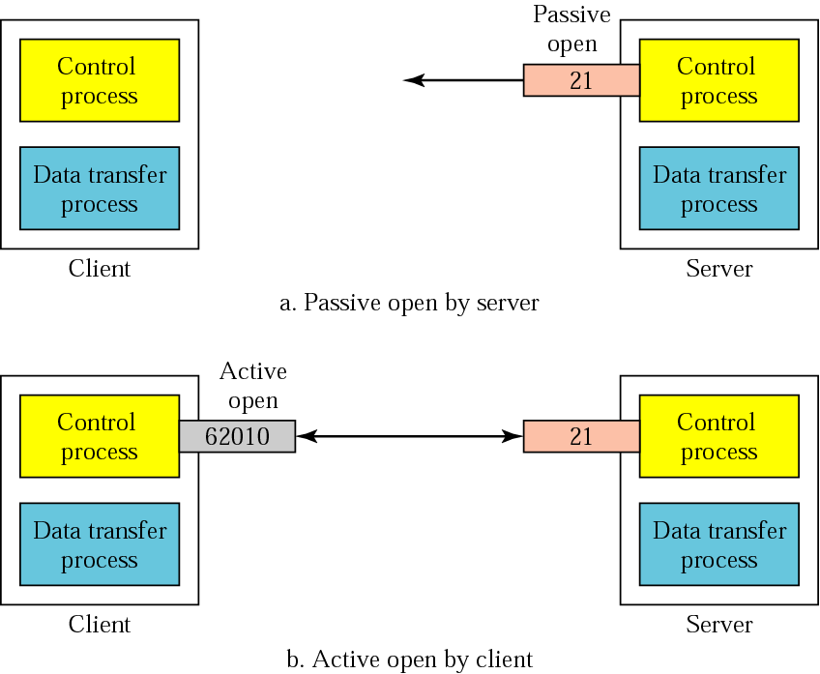

Slide 20
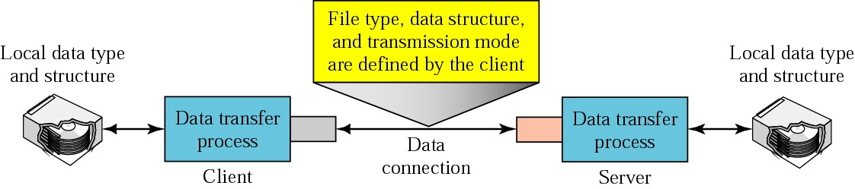
Using the data connection

Slide 21
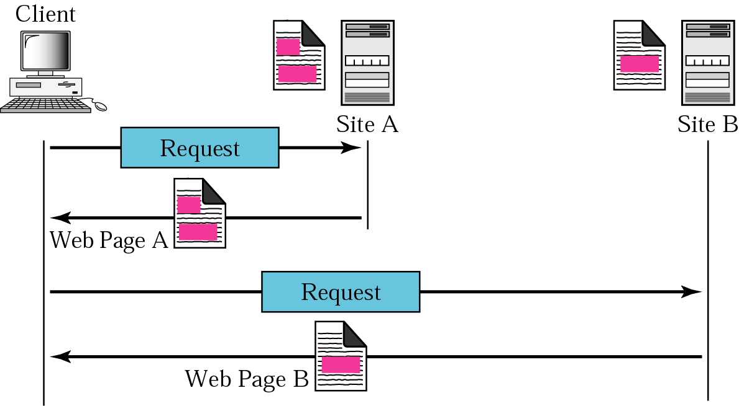
Architecture of WWW
WWW
The WWW is a distributed client-server service, in which a client using a browser can access a service using a server
The service provided is distributed over many locations called sites.

Slide 22
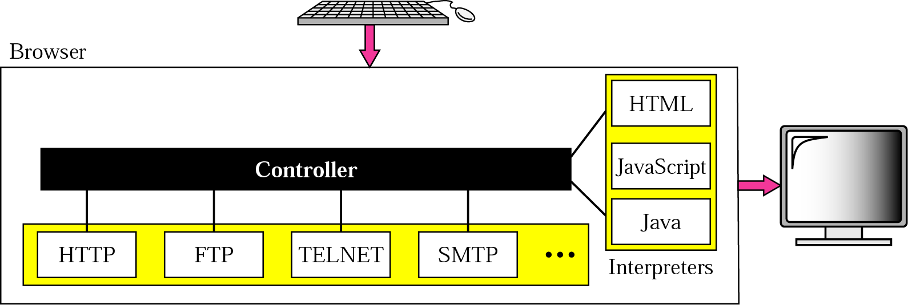
Browser
URL

Slide 23
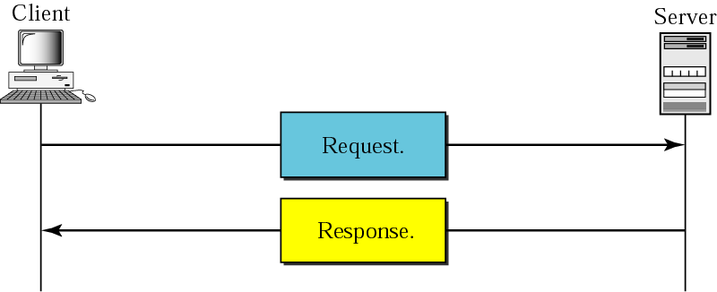
HTTP
The Hypertext Transfer Protocol (HTTP) is a protocol used mainly to access data on the World Wide Web.
HTTP functions like a combination of FTP and SMTP.
HTTP uses the services of TCP on well-known port 80.
HTTP transaction

Slide 24
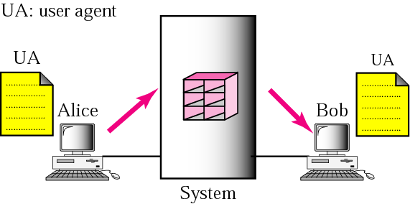
SMTP
To explain the architecture of email, we give few scenarios
We begin with the simplest situation and add complexity as we proceed
The fourth scenario is the most common in the exchange of email
First scenario
When the sender and the receiver of an email are on the same system, we need only two user agents

Slide 25
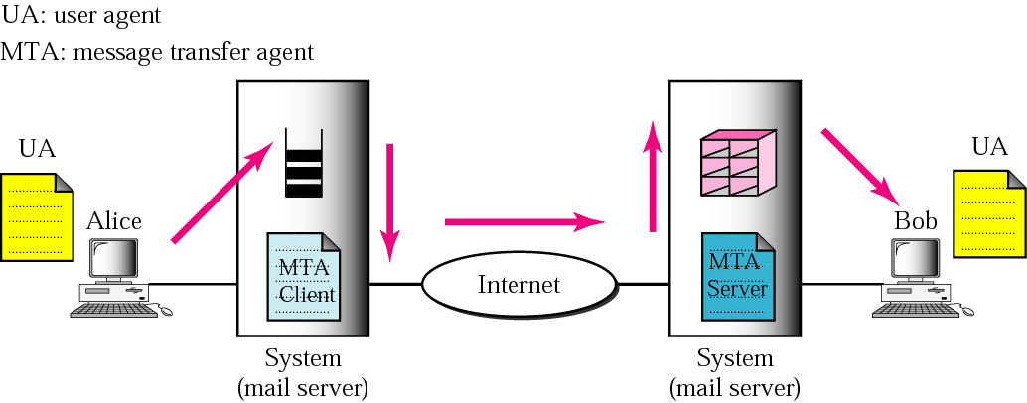
Second scenario
When the sender and the receiver of an email are on different systems, we need two UAs and a pair of MTAs (client and server)

Slide 26
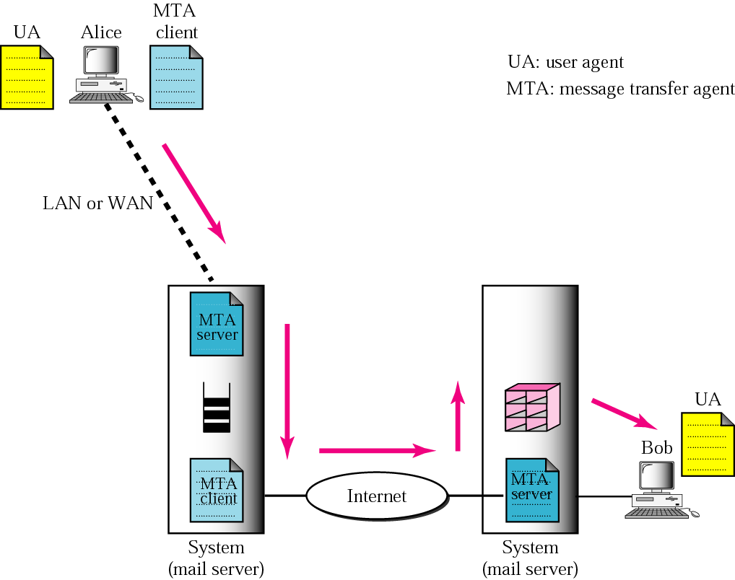
Third scenario
When the sender is connected to the mail server via a LAN or a WAN, we need two UAs and two pairs of MTAs (client and server)

Slide 27
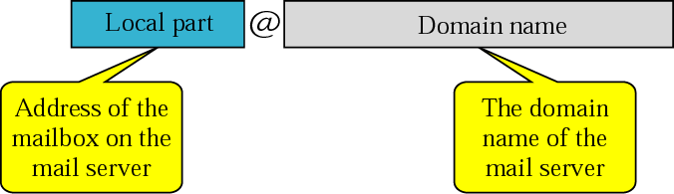
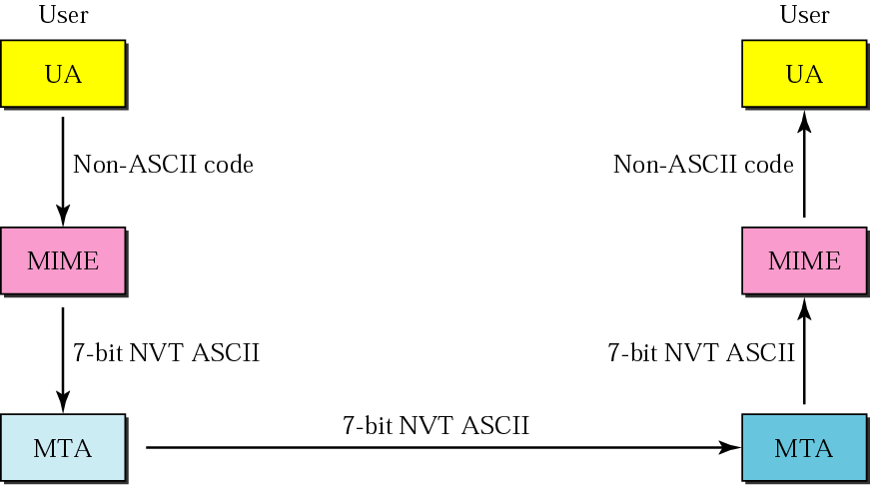
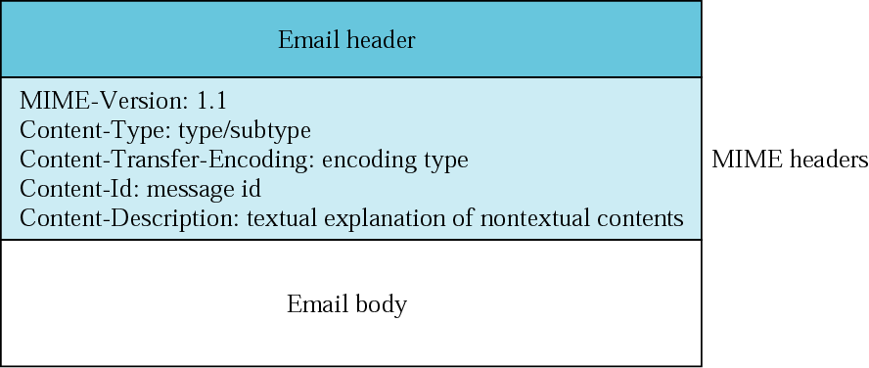
Email address
MIME

Slide 28
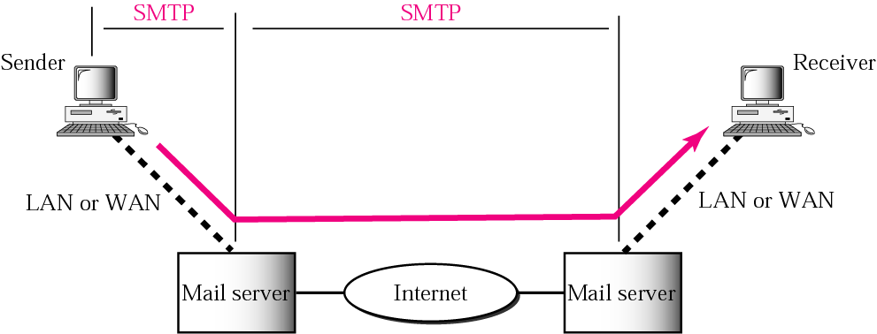
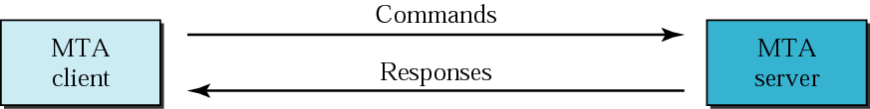
Commands and responses
MTA
The actual mail transfer requires message transfer agents (MTAs)
The protocol that defines the MTA client and server in the Internet is called Simple Mail Transfer Protocol (SMTP).

Slide 29
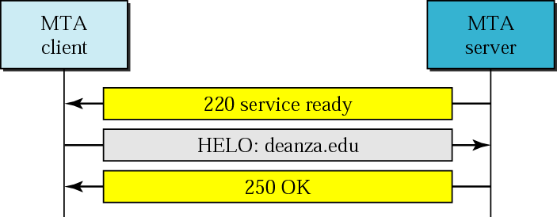
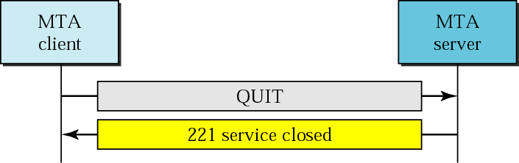
Connection termination
Connection establishment

Slide 30
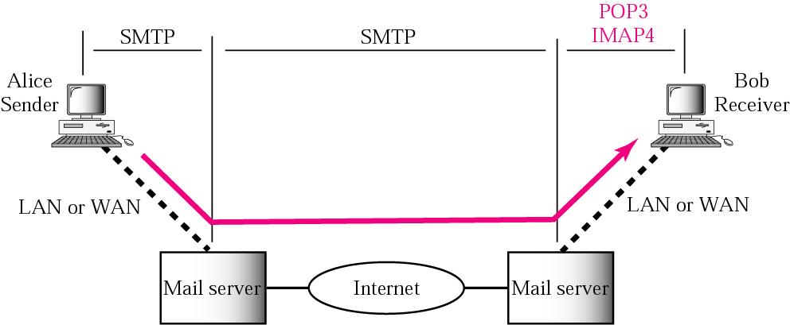
Message Access Agent: POP and IMAP
The third stage of mail delivery uses a message access agent; the client must pull messages from the server
Currently two message access protocols are available
Post Office Protocol, version 3 (POP3)
Internet Mail Access Protocol, version 4

Slide 31
Network Virtual Terminal (NVT)
Telnet
TELNET enables the establishment of a connection to a remote system in such a way that the local terminal appears to be a terminal at the remote system.
TELNET is a general-purpose client-server application program.
Via a universal interface called the Network Virtual Terminal (NVT) character set, the TELNET client translates characters (data or commands) that come from the local terminal into NVT form and delivers them to the network
TELNET server translates data and commands from NVT form into the form
acceptable by the remote computer.

Slide 32
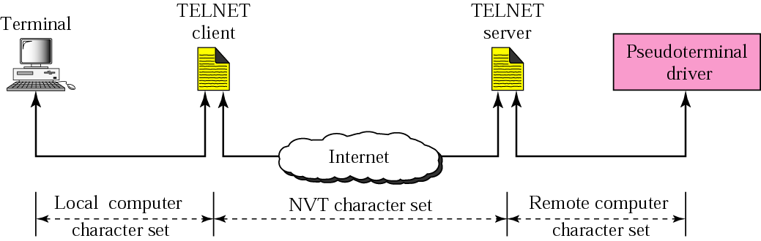
Concept of NVT

